Slide 1
Climate Model Diagnostic Analyzer: Web Service System
Seungwon Lee, Chengxing Zhai, Lei Pan, Jonathan Jiang, Benyang Tang
Jet Propulsion Laboratory
Funded by NASA ROSES CMAC-11 Program

Slide 2
Introduction
Climate Model Diagnostic Analyzer (CMDA) enables multi-aspect physics-based climate data analyses through comprehensive and synergistic use of observational data, reanalysis data, and model outputs.
CMDA has a web-service oriented system is a set of web services with a web interface that lets a user to interact with the web server hosting CMDA server directly through on a web browser.
No local software/library installation is needed. All computing is computations are done in on the web server that hosts CMDA.
No raw data download to the user disk is needed. All relevant datasets involved are stored in on the disk storage connected to the web server.
Each user is assigned to their own web server, which is running on the Amazon cloud system. There is no competing in computational resources conflicts/overload among users.

Slide 3
Data Sets
Model Outputs from CMIP5 project
Experiments:
Historical runs and AMIP runs
Models:
CCCMA/canesm2, GFDL/esm2g, GISS/e2-h, GISS/e2-r, NCAR/cam5, NCC/noresm, UKMO/hadgem2-es, CCCMA/canam4, CSIRO/mk3.6, GFDL/cm3, IPSL/cm5a-lr, MIROC/miroc5, UKMO/hadgem
To be Evaluated
References
Observation Data from Obs4MIPs
AMSR-E surface temperature
AIRS and MLS air temperature & water vapor content
MODIS total cloud fraction, leaf area index
GPCP and TRMM precipitation
AVISO sea surface height
CERES radiation fluxes
References
Reanalysis Data from ECMWF
Vertical Wind
Relative Humidity

Slide 4
Analysis Tools
Single Variable Analysis
Double Variable Analysis
2-D Variable Analysis
3-D Variable Analysis
temporal averaging and plotting
time series generation and plotting
zonal mean calculation and plotting
vertical profile averaging and plotting
pressure-level slicing and plotting
zonal mean calculation and plotting
correlation calculation
scatter plotting
histogram
difference calculation and plotting
conditional sampling

Slide 5
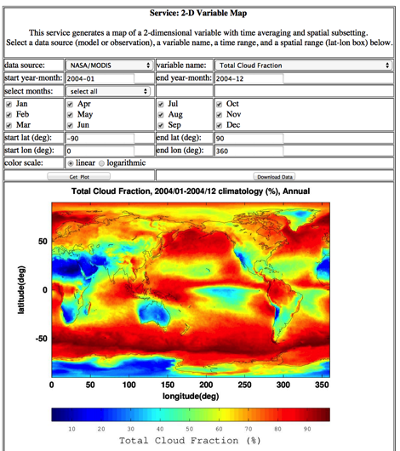
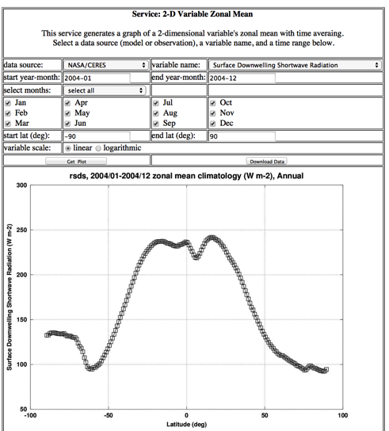
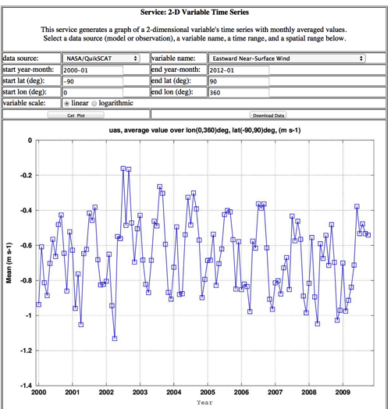
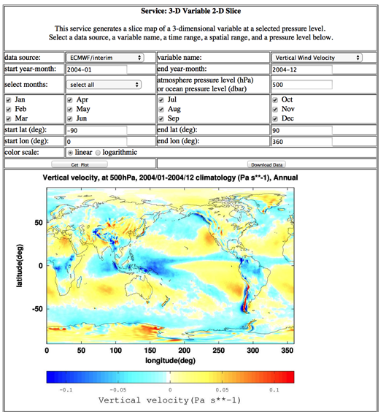
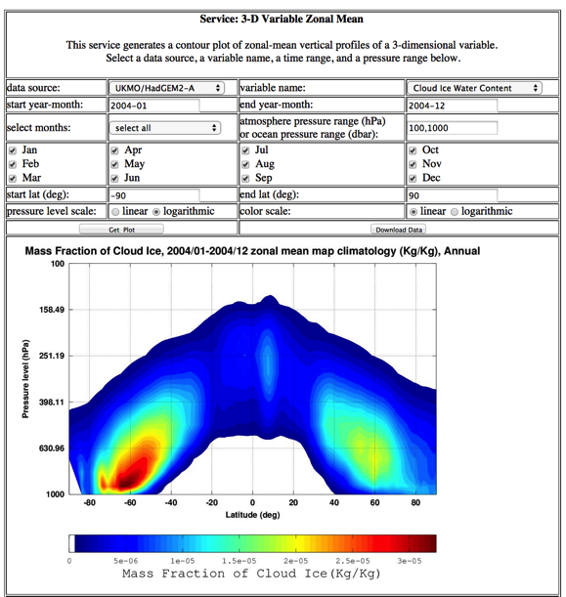
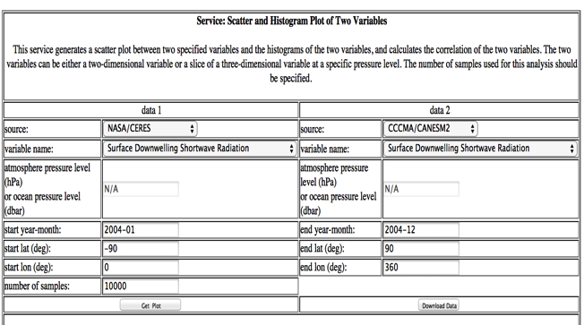
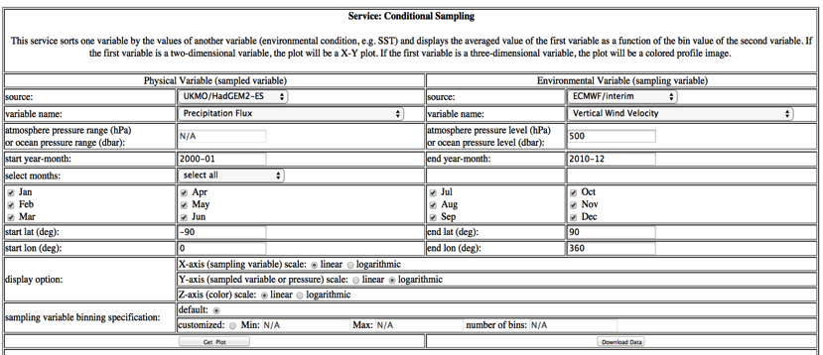
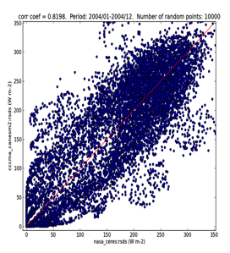
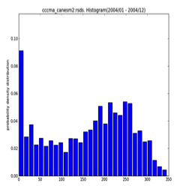
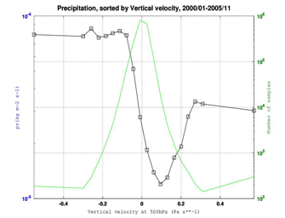
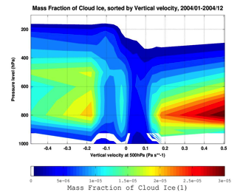
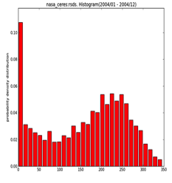
Analysis Tool Screenshots

Slide 6
Approach Flow Chart
Develop Analysis Tool
Integrate web-service system into Cloud
Wrap Analysis Tool with Python Caller
Virtualize web-service system
Build Web Service
Build Web Browser Interface

Slide 7
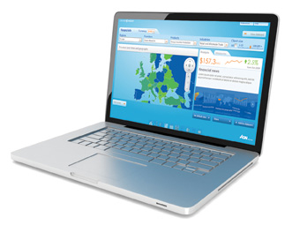


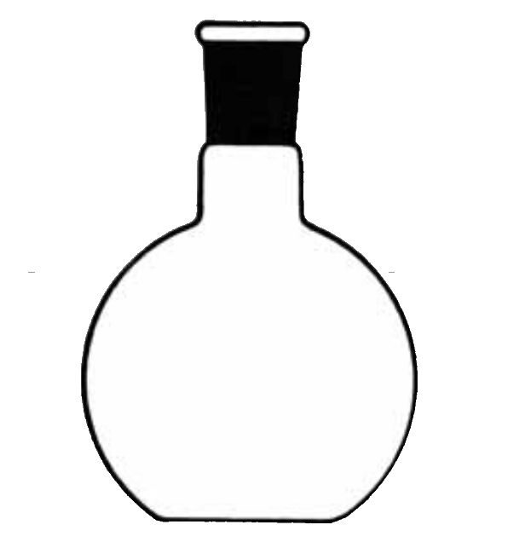



Technical Components of Web Services
Client
(Web Browser, JavaScript)
URI
(scoping + method)
URI
(results)
JSON
Octave App.

Slide 8
Educational Use
CMDA was used as an educational tool for the Summer School organized by JPL’s Center for Climate Science in September 22-26, 2014.
The theme of the Summer School in 2014 was “Using Satellite Observations to Advance Climate Models”.
23 students attended the summer school: graduate students or postdocs from around the world.
Five research topics were prepared by the JPL Earth scientists.
The students worked on their respective research topics for a total of 5 hours of group research time.
Each student was assigned to a virtual machine in Amazon Cloud to use CMDA.
An one-hour session of the CMDA introduction was given and the students were able to use the tool immediately to do their research.
The students presented their results on the last day of the school.

Slide 9
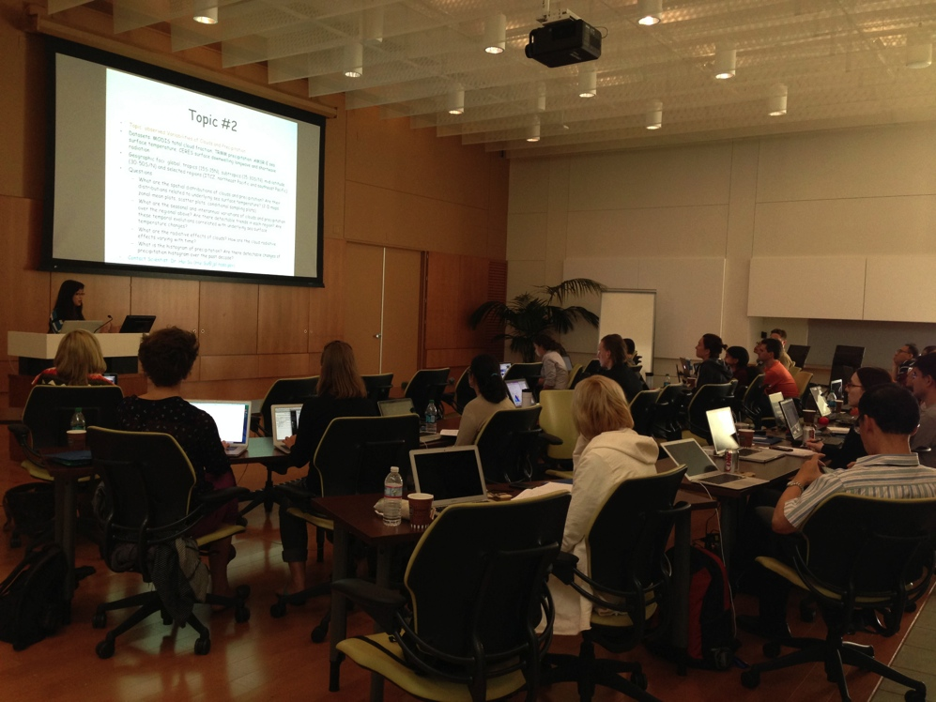
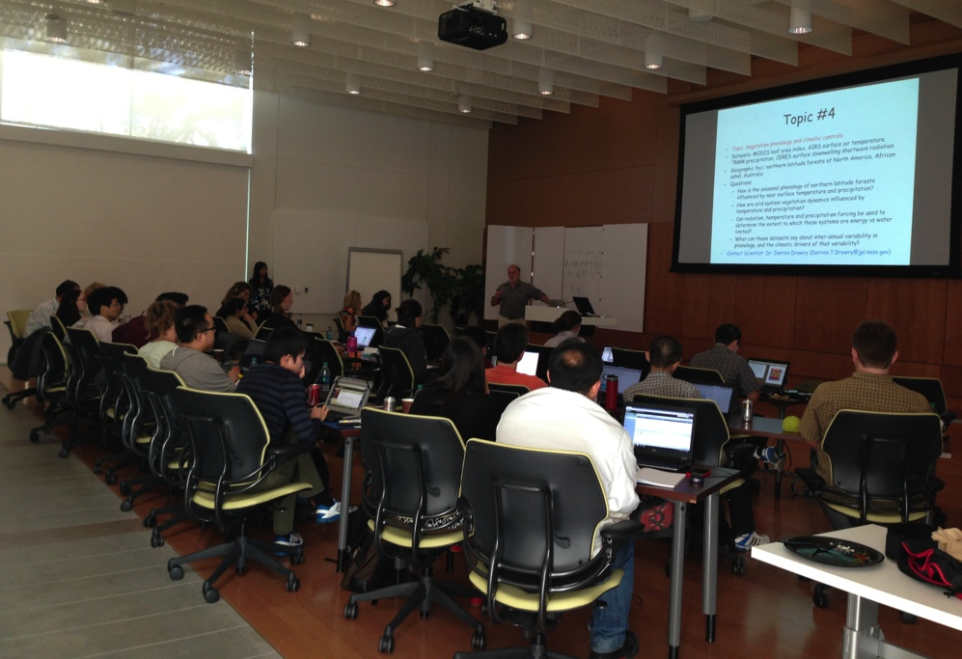
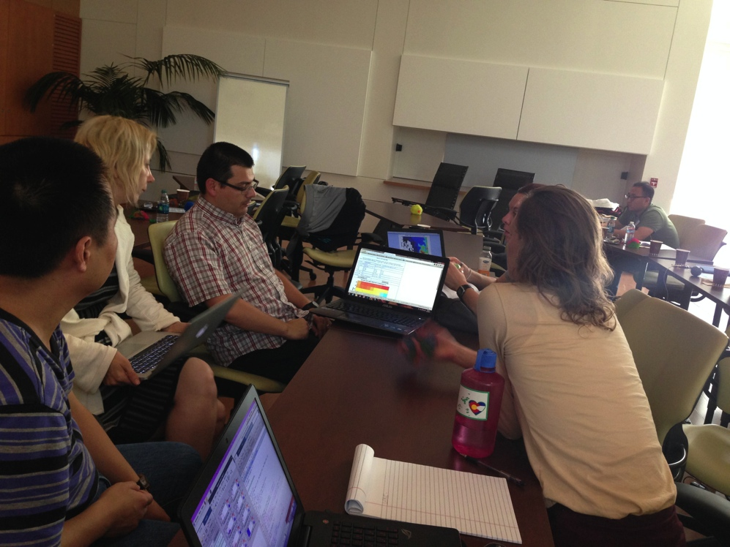
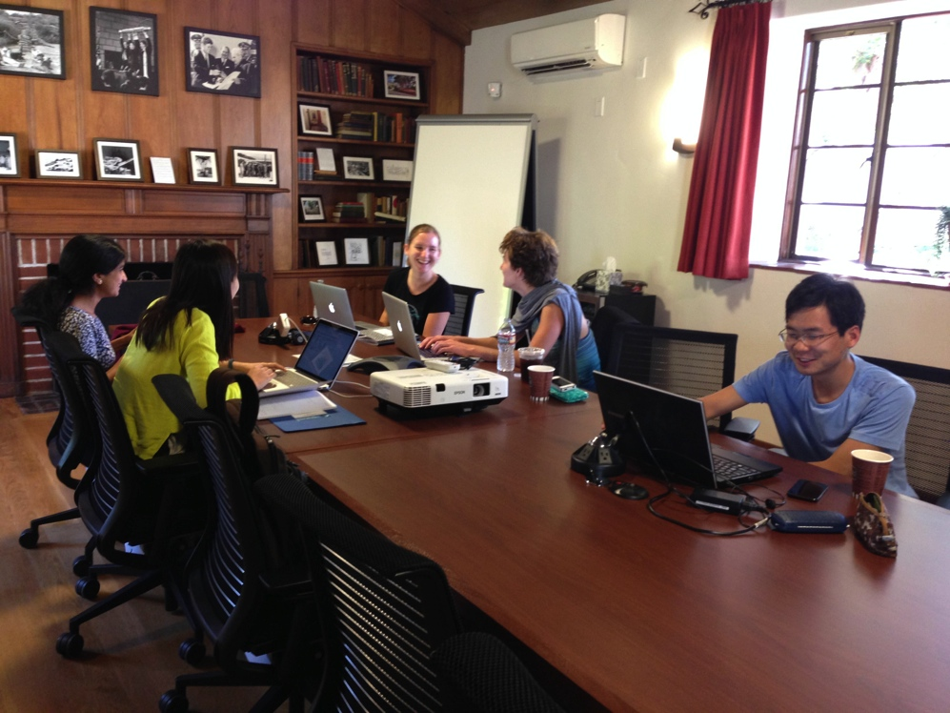
2014 JPL Summer School

Slide 10
Student Feedback
A tool survey was given to students, and students comments were collected.
Comments from students for appreciation:
“I found the tool to be very user-friendly.”
“It is really straightforward to use.”
“It is not so difficult to use, seems intuitive.”
“It was very useful for the exploratory analysis”
“The web tool was pretty instrumental in the completion of the research project.”
“I could see this tool being easily used in classroom settings.”
Comments from students for improvement:
“Provide a comprehensive description of the datasets available.”
“Provide the time ranges over which the variables are available.”
“Provide a tool to download data with a user specified condition (time, space, grid resolution for more detailed analyses in other programs.”
“Provide interactive visualization capabilities: interactive space selection, color range selection, etc.”
“Provide an exemplary picture of each analysis tool’s output”

Slide 11
Conclusions
Climate Model Diagnostic Analyzer (CMDA)
Is a web-service oriented system web-based tool to enable multi-aspect physics-based climate data analyses.
Supports the comprehensive use of multiple observational data, reanalysis data, and model outputs.
Requires no local installation nor local data storage.
Is integrated into Amazon cloud environment using JPL EarthKit.
Was used as an educational tool for the summer school organized by JPL’s Center for Climate Science in Sep 2014.
Is proven to be easy to use and customizable for education.
Is actively developed to add new features and capabilities: user work flow design, execution provenance collection and query, etc.
Will be an open-source Apache project soon.

Slide 12
CMDA Web Servers
Local Server (open for public)
http://cmacws4.jpl.nasa.gov:8080/cmac
Cloud Computing (open only during the summer school)
http://climate.earthkit.jpl.net/
We are looking for new collaboration for educational and scientific use of CMDA (Please contact the authors).

Slide 13
Back-up Slides

Slide 14
CMDA Analysis Tools: Screenshots

Slide 15

2D variable temporal averaging

Slide 16

2D variable zonal mean

Slide 17
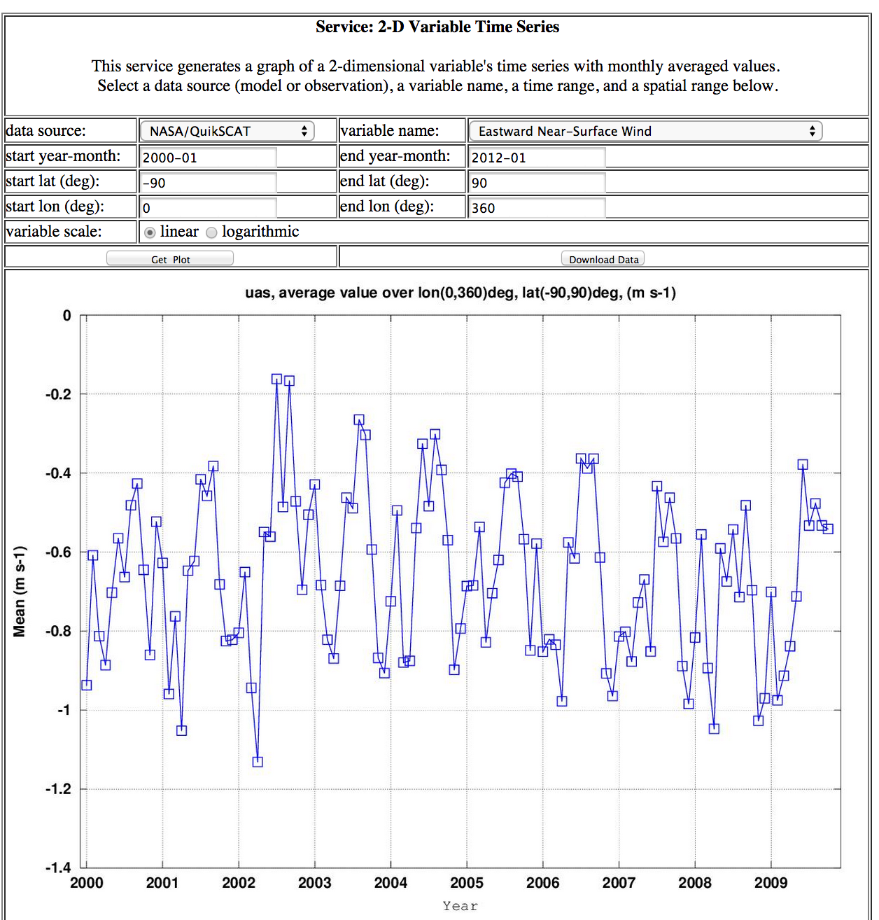
2D variable time series

Slide 18

3D variable pressure-level slice

Slide 19

3D variable zonal mean

Slide 20
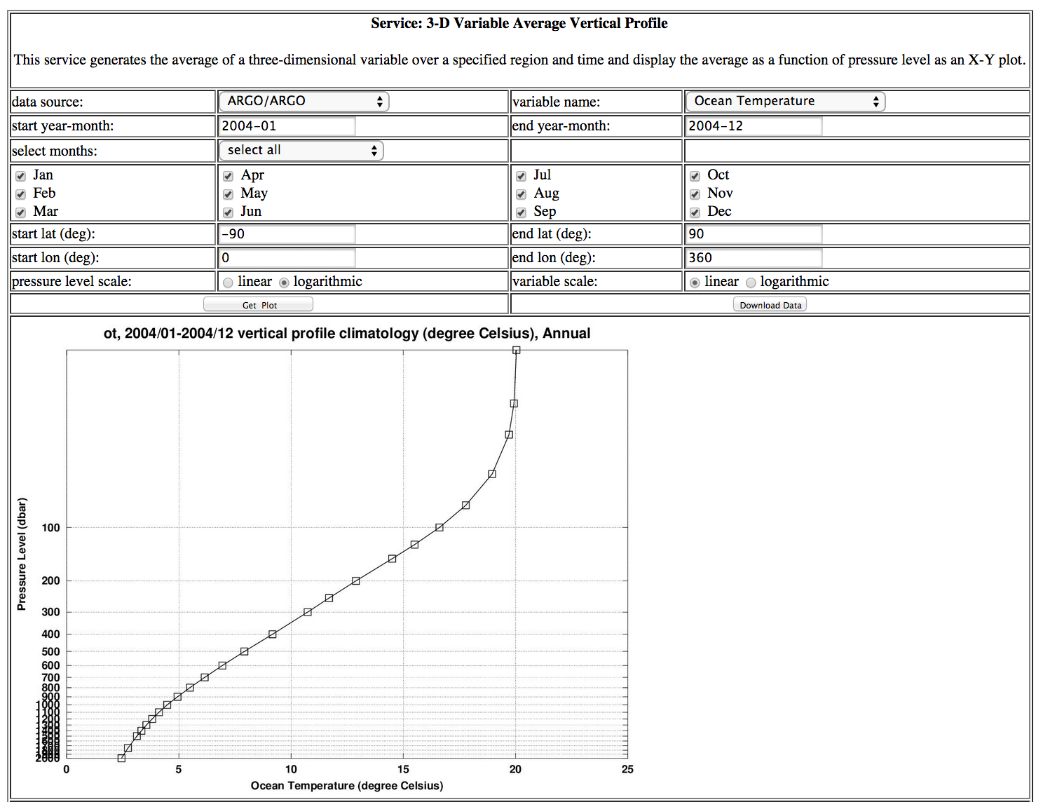
3D variable average vertical profile

Slide 21
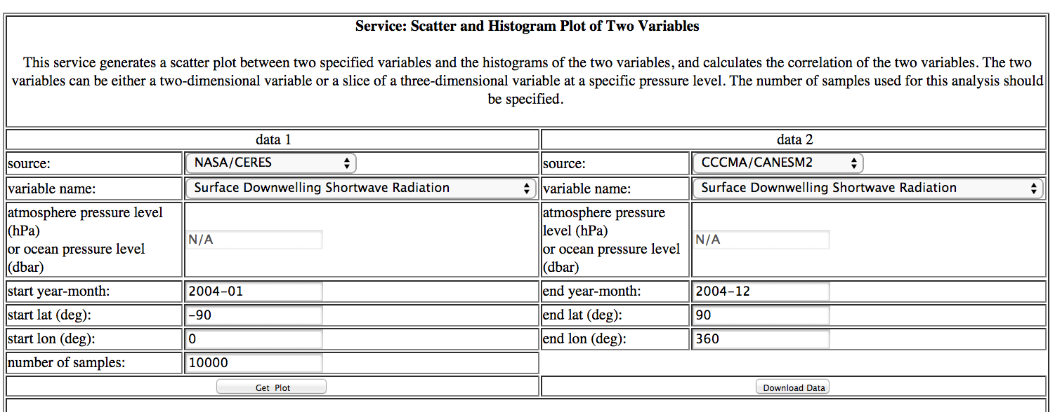



Correlation/Scatter/Histogram

Slide 22
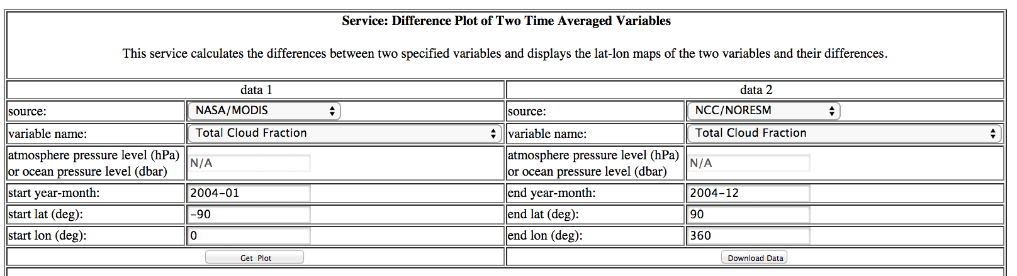
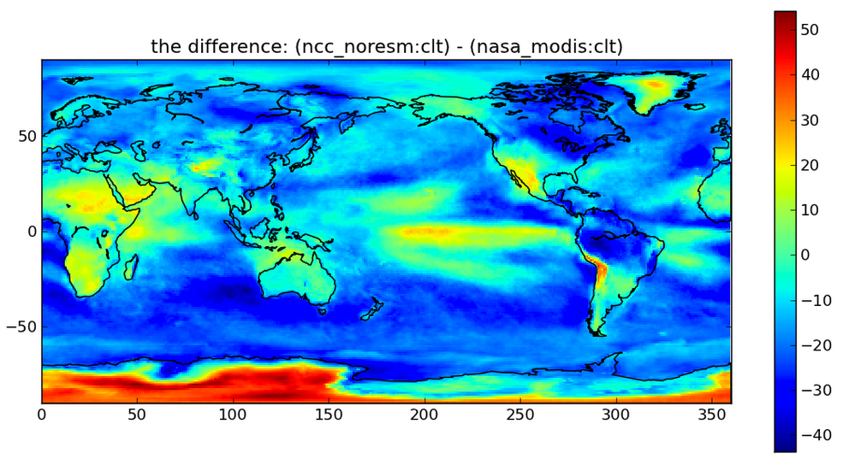
Difference Plot

Slide 23

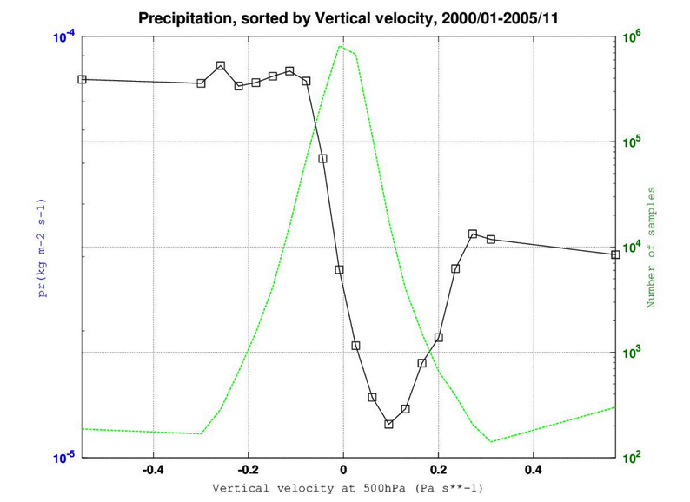
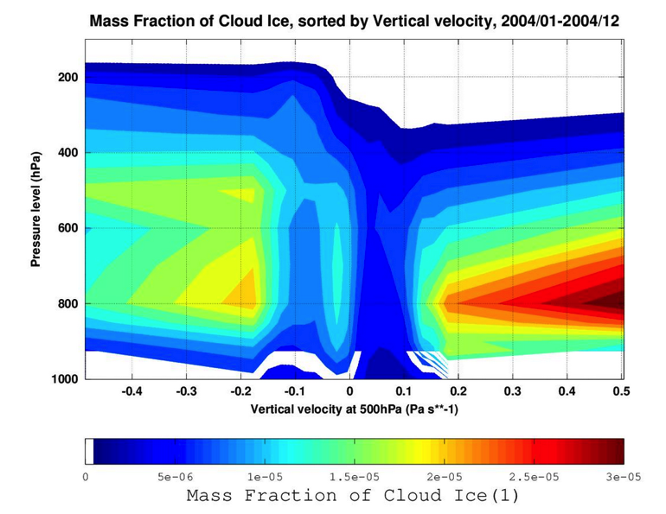
Conditional Sampling

Slide 24
Student Group Research Topics
2014 Summer School,
JPL Center for Climate Sciences

Slide 25
Topic #1
Topic: surface and deep ocean connections
Datasets: ARGO deep ocean temperature, AMSRE sea surface temperature
Geographic foci: high latitudes (+-90-60), mid latitudes (+-60-30), low latitudes (+-30-0)
Questions:
How is the seasonal cycle of the observations related to model output? Are there regional differences in agreement?
Besides the seasonality – are there other features in the time series you observe? Are they regionally dependent and can you identify potential causes?
How are the surface temperatures related to the deep temperatures? Is there a depth where the relationship breaks down? Are there regional differences? Try to identify causes.
Contact Scientist: Dr. Carmen Boening (Carmen.Boening@jpl.nasa.gov)

Slide 26
Topic #2
Topic: observed Variabilities of Clouds and Precipitation
Datasets: MODIS total cloud fraction, TRMM precipitation, AMSR-E sea surface temperature, CERES surface downwelling longwave and shortwave radiation
Geographic foci: global, tropics (15S-15N), subtropics (15-30S/N), mid-latitude (30-50S/N) and selected regions (ITCZ, northeast Pacific and southeast Pacific)
Questions:
What are the spatial distributions of clouds and precipitation? Are their distributions related to underlying sea surface temperature? (2-D maps; zonal-mean plots; scatter plots; conditional sampling plots)
What are the seasonal and interannual variations of clouds and precipitation over the regional above? Are there detectable trends in each region? Are these temporal evolutions correlated with underlying sea surface temperature changes?
What are the radiative effects of clouds? How are the cloud radiative effects varying with time?
What is the histogram of precipitation? Are there detectable changes of precipitation histogram over the past decade?
Contact Scientist: Dr. Hui Su (Hui.Su@jpl.nasa.gov)

Slide 27
Topic #3
Topic: modelled spatial and temporal variabilities of clouds and precipitation
Datasets: CMIP5 simulations of total cloud fraction, precipitation and surface radiative fluxes
Geographic foci: global, tropics (15S-15N), subtropics (15-30S/N), mid-latitude (30-50S/N) and selected regions (ITCZ, northeast Pacific and southeast Pacific)
Questions: How do climate models simulate the spatial and temporal variabilities of clouds and precipitation? Are model performances related to models’ climate sensitivity?
Approach: compare modeled and observed clouds and precipitation in 2-D maps, zonal-mean plots, time series, scatter plots, difference plots; conditional sampling plots; then group models by high-climate-sensitivity and low-climate sensitivity models
Models’ equilibrium climate sensitivity (K):
CCCMA/CANESM2: 3.69
GFDL/ESM2G: 2.39
GISS/E2H: 2.30
GISS/E2R: 2.11
Contact Scientist: Dr. Hui Su (Hui.Su@jpl.nasa.gov)
NCAR/CAM5: 4.1
NCC/NORESM: 2.8
UKMO/Hadgem2-ES: 4.59

Slide 28
Topic #4
Topic: Vegetation phenology and climatic controls
Datasets: MODIS leaf area index, AIRS surface air temperature, TRMM precipitation, CERES surface downwelling shortwave radiation
Geographic foci: northern latitude forests of North America, African sahel, Australia
Questions:
How is the seasonal phenology of northern latitude forests influenced by near surface temperature and precipitation?
How are arid system vegetation dynamics influenced by temperature and precipitation?
Can radiation, temperature and precipitation forcing be used to determine the extent to which these systems are energy vs water limited?
What can these datasets say about inter-annual variability in phenology, and the climatic drivers of that variability?
Contact Scientist: Dr. Darren Drewry (Darren.T.Drewry@jpl.nasa.gov)

Slide 29
Topic #5
Topic: Land water storage variability as a function of human and natural controls
Datasets: GRACE moisture storage (equivalent water height over land), TRMM precipitation, CERES surface downwelling shortwave radiation
Geographic foci: Northern India, southwest US
Questions:
Is there an apparent seasonality in GRACE soil water storage in heavily managed (agricultural) regions?
How does that seasonality temporally align with seasonality in precipitation, relative to the agricultural seasons when soil water is used for irrigation?
From these datasets, what conclusions can we draw regarding the primary driver of soil water storage in this system? Can these datasets be used to identify energy and water-limited environments?
Contact Scientist: Dr. Konstantinos Andreadis (Konstantinos.M.Andreadis@jpl.nasa.gov)

Slide 30
Student Group Research Reports
2014 Summer School,
JPL Center for Climate Sciences

Slide 31
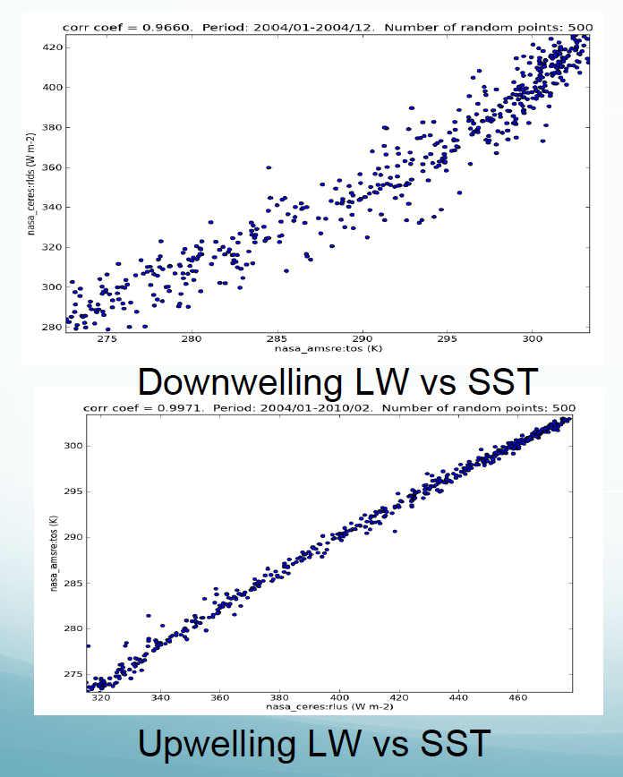
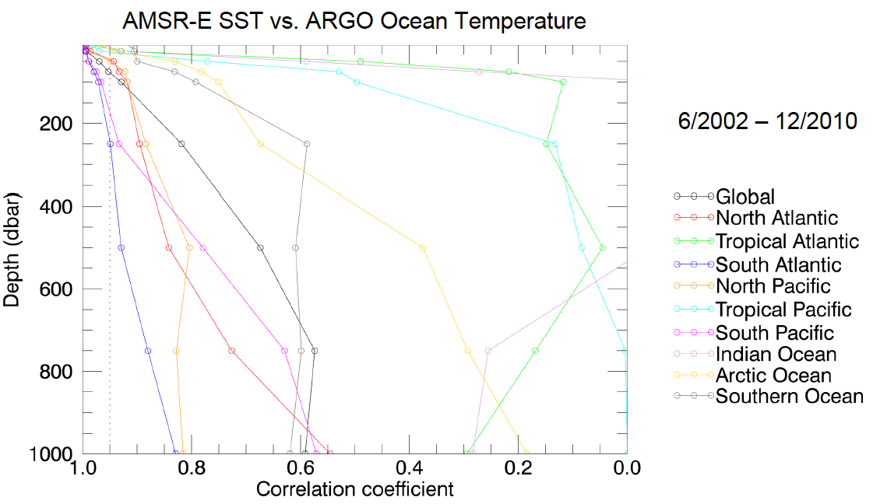
Student Report Topic #1
Models best at mid-latitudes.
Seasonal signals due to data availability.
SST correlated to temperature at depth in some ocean basins.
Warming in some parts of the ocean over the last decade.
Longwave radiation is correlated to SST.

Slide 32
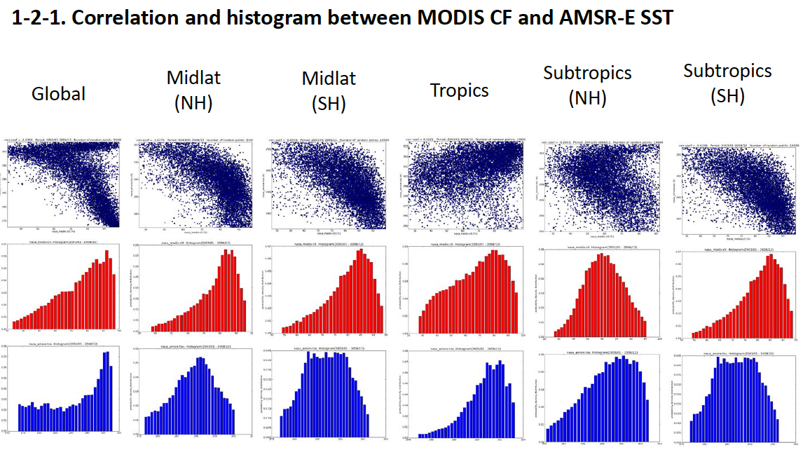
Student Report Topic #2
Regional difference of correlation between cloud fraction and SST.
Some particular trends of cloud fraction in tropics are discovered.
Zonal mean analysis may not be the best way to see variation of cloud and precipitation.

Slide 33
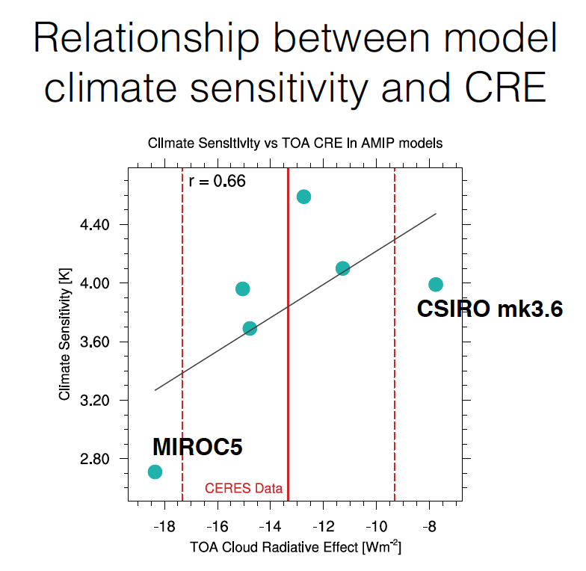
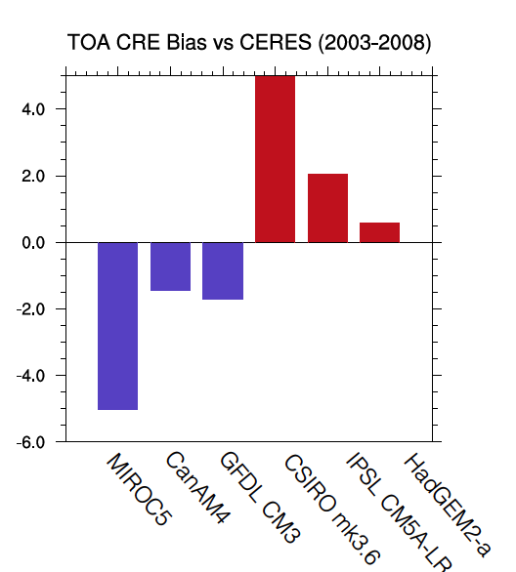
Student Report Topic #3
Top-of-atmosphere (TOA) Cloud Radiative Effect (CRE) is correlated with model climate sensitivity.
Low Sensitivity models have negative biases of CRE, high sensitivity models tend to have positive biases.

Slide 34
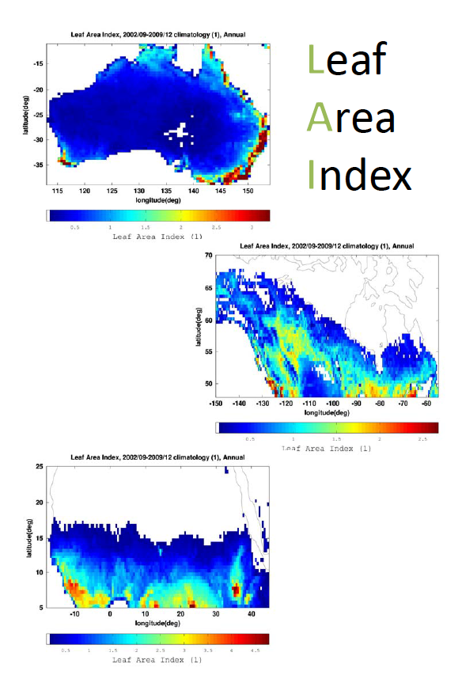
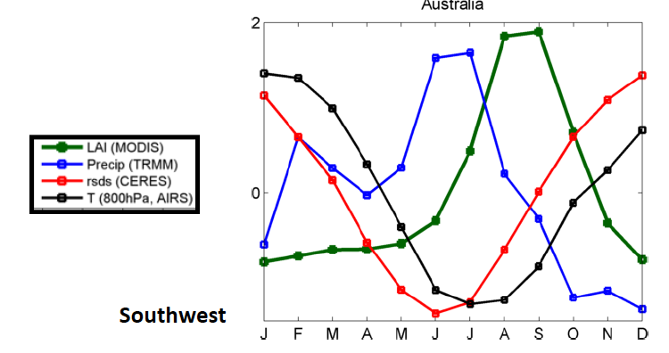
Student Report Topic #4
Southwest
Australia
Australia: water-limited, two rainy/vegetation seasons from different geographic areas
North America Forests: energy-limited
African Sahel: water-limited, lag from peak precipitation to peak Leaf Area Index.

Slide 35
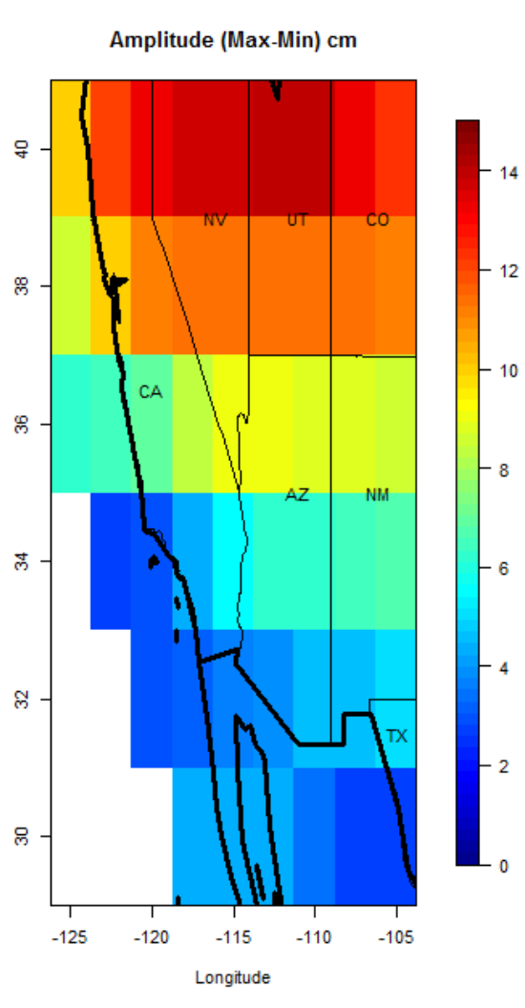
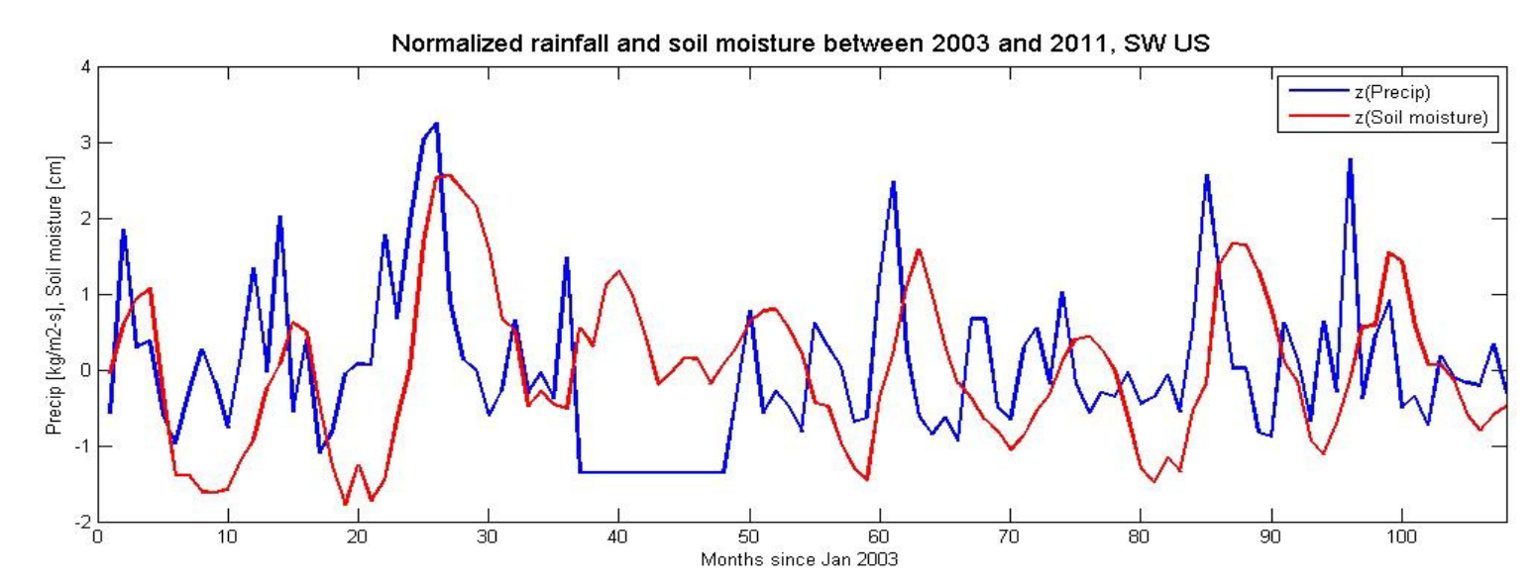
Student Report Topic #5
The observations confirm the existence of seasonality in precipitation and soil moisture.
The northern portion of the study area exhibits more pronounced seasonality.
Soil moisture shows memory.
Seasonal lag between precipitation and soil moisture, which could be related to local geology.

